Slide 1

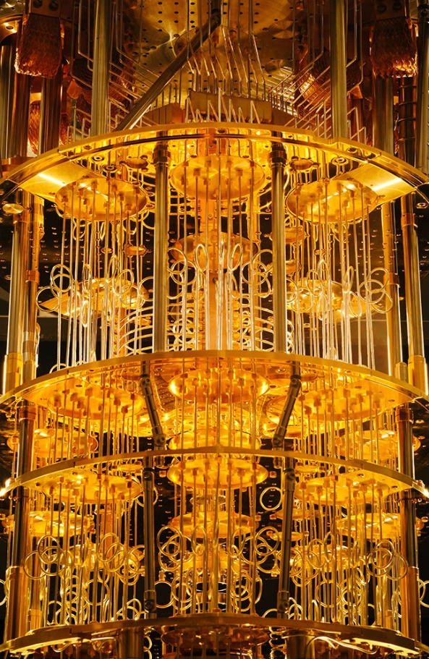
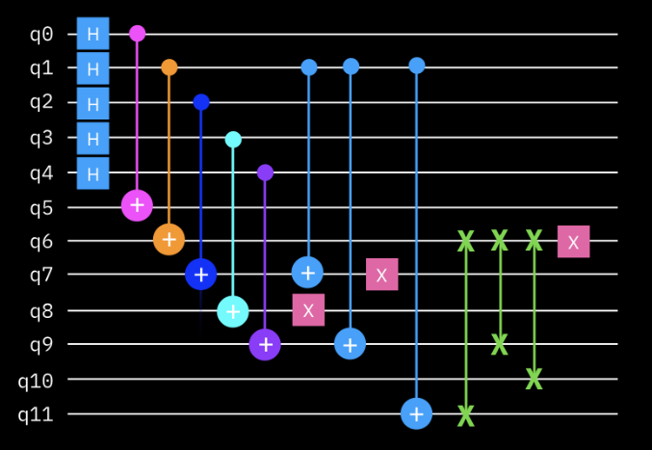
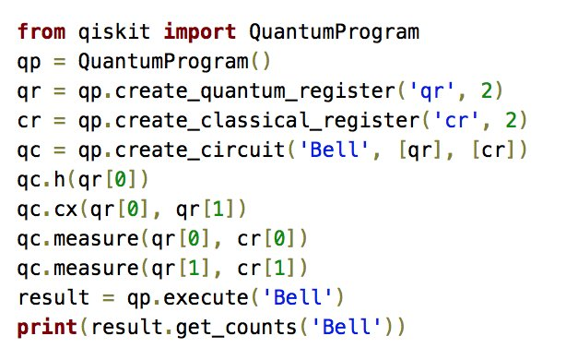
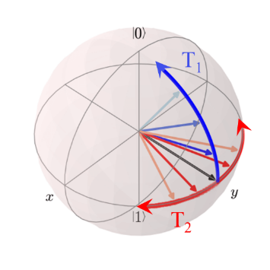

Foundations of
Quantum Information Science (QIS 101)
Dave Biersach
Brookhaven National Laboratory
dbiersach@bnl.gov
Tasks - Session 21
Monte Carlo Methods

Slide 2
Task 21-01
Create a Python program called mc_exp_dist.py that uses Monte Carlo estimation to calculate the probability that an event will occur within one hour of an exponential distribution having a rate parameter of 90 minutes
Take a minimum of 25,000 random samples and then indicate, via different colors, which of those random samples are above or below the PDF curve
On the same graph, use matplotlib to graph the PDF of this distribution
Calculate and display the absolute percent relative error of your estimate for this probability versus the exact probability
Upload your solution to the BNL QIS101 SharePoint site

Slide 3
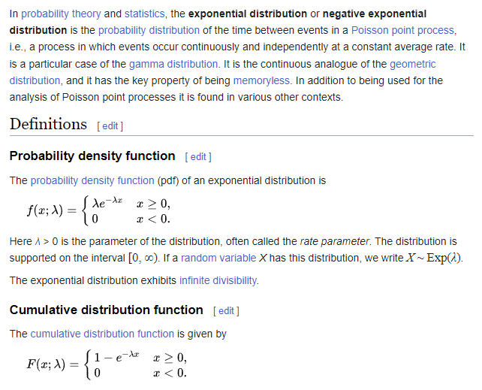

Exponential Distribution
https://en.wikipedia.org/wiki/Exponential_distribution
$$λ=\frac{60}{90}=\frac{2}{3}$$

Slide 4
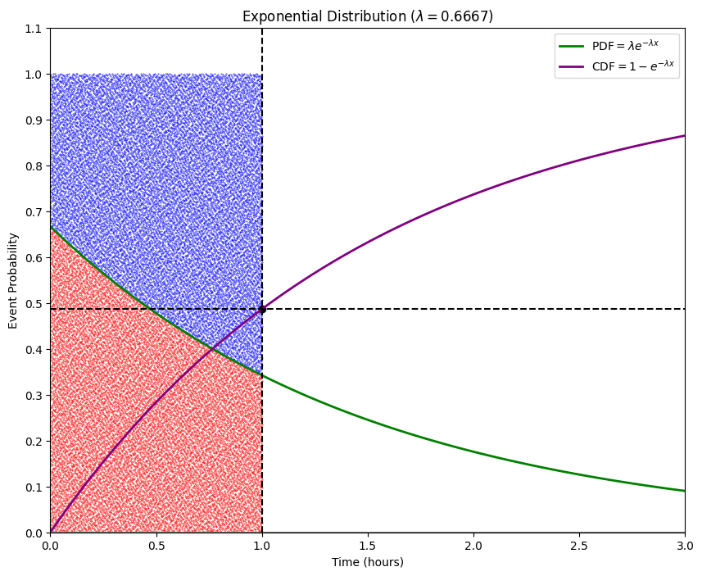
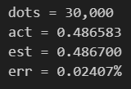
There is a 48% chance an event will occur within the first hour of a system governed by an exponential distribution having a rate parameter of 90 minutes

Slide 5
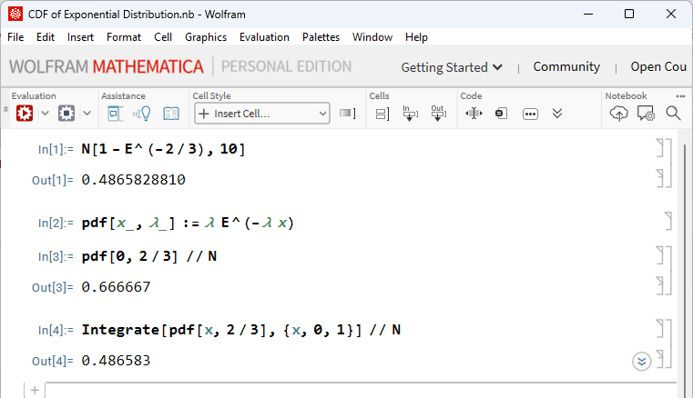

Slide 6
Task 21-02
Fix the code in sphere_sampling.py to correct the problem where randomly sampled points across the surface of a 3D unit sphere bunch together at the north and south poles
The naive approach of picking a random poloidal angle $\left(0≤φ<π\right)$ and a random toroidal angle $\left(0≤θ<2π\right)$ does not produce a uniform (fair) sampling across the entire face of the sphere
Consider what it is about the geometry of the sample space, as seen from the basis (perspective) of spherical coordinates, that causes the sampling "density" to deviate from a uniform distribution
Upload your solution to the BNL QIS101 SharePoint site

Slide 7
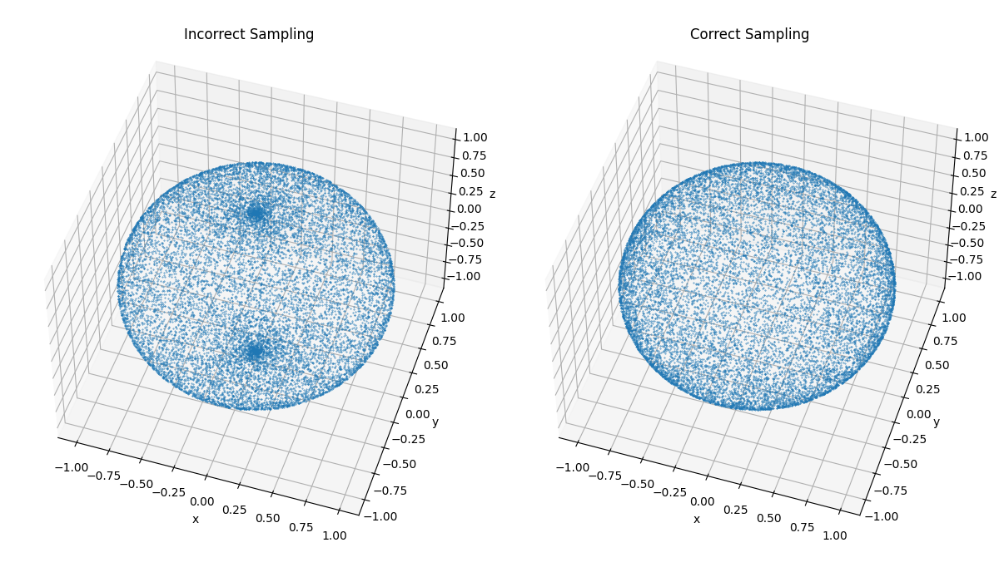
Task 21-02 (hint)
What went wrong with our math?
What must we do to sample smoothly?

Slide 8
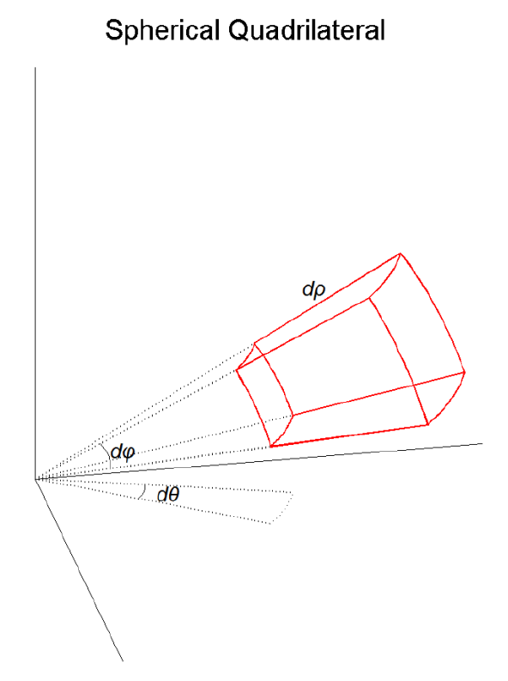
Fair Point Picking on the Sphere
https://apps.dtic.mil/sti/pdfs/ADA626479.pdf

Slide 9
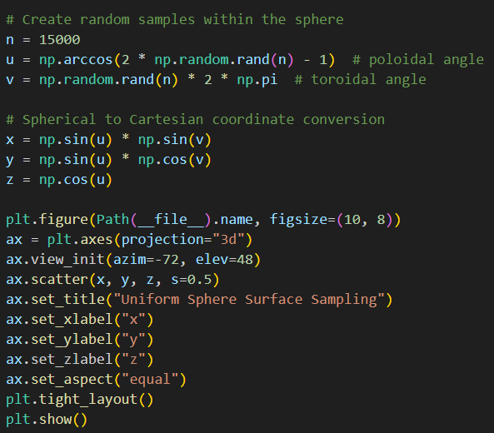

Slide 10
Fair Point Picking on the Sphere

